Slide 1
Dilated Cardiomyopathy
Brittany Woznicki, RN, BSN
Alverno College
March 2012
MSN 621

Slide 2
What to Expect!
This tutorial will go through the explanation of Dilated Cardiomyopathy
The purple slides have interactive abilities to facilitate your learning.
Underlined words in yellow give you additional information about the topic when you hover over them with the mouse arrow.
To progress through the slides, simply use the navigation arrows in the lower left corner.
At any time if you wish to go back to a previous slide, right click on the mouse and click “previous” or again use the navigation arrows in the bottom left corner.

Slide 3
Objectives
The learner will be able to:
  Identify causes of dilated cardiomyopathy
  Explain the etiology of dilated cardiomyopathy and how it causes its clinical manifestations
  Identify complications caused by the disease and how to identify them in your patient
  Identify different treatments for this disease

Slide 4
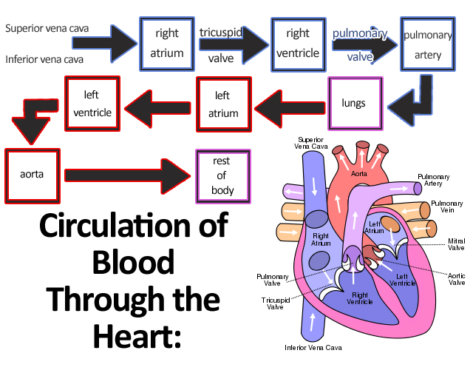
The Heart...
“propels blood through the circulatory system.”
(Porth, 2009, p. 451)
(Image retrieved from Wikipedia.org)

Slide 5
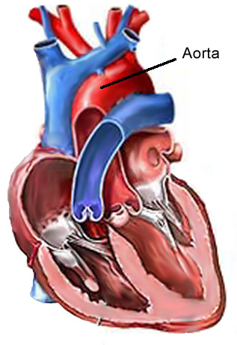
Anatomy of the Heart
Myocardium
Pericardium
Endocardium
Endocardium
Pericardium
Myocardium
(Image retrieved from wikimedia.org)
(Porth, 2009)

Slide 6
Pathophysiology of the Heart
(Terms and Definitions)
Two main parts to the cardiac cycle:
  Diastolic
  Systolic
In order to determine how hard the heart is working you must understand the two terms:
  Preload: the volume of blood the heart pumps out
  Afterload: the pressure required for the heart to pump the blood out
Ejection Fraction: “the percentage of blood pumped out of the ventricles with each contraction” (Porth, 2009, p.609).
  Normal: ≈65%
(Porth, 2009)

Slide 7
What is Cardiomyopathy?
“a heterogeneous group of diseases of the myocardium associated with mechanical and/or electrical dysfunction that usually (but not invariably) exhibit in appropriate ventricular hypertrophy or dilation and are due to a variety of causes that frequently are genetic (Porth, 2009, p.554).”
Image from Microsoft Office Clip Art

Slide 8
Dilated Cardiomyopathy is…
Click the box to find out more!
A Mixed Cardiomyopathy
Dilated Cardiomyopathy has been found to have both genetic and non-genetic causes.
A Primary Cardiomyopathy
Meaning the condition is limited to the myocardium of the heart.
A Common Cause for Heart Failure
Dilated cardiomyopathy often is a common cause for heart failure by causing mechanical alteration of the hearts ability to pump.
An Idiopathic Dilated Cardiomyopathy
Dilated Cardiomyopathy often times has no identifiable cause!
(Porth, 2009)

Slide 9
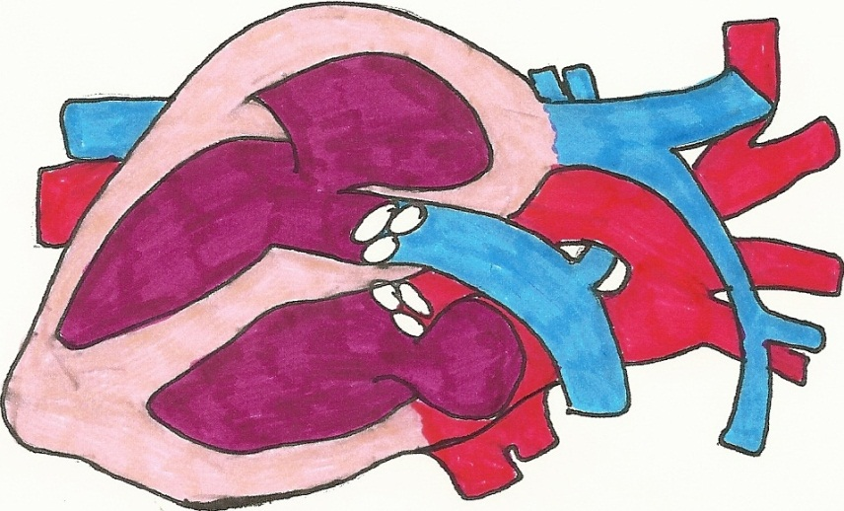
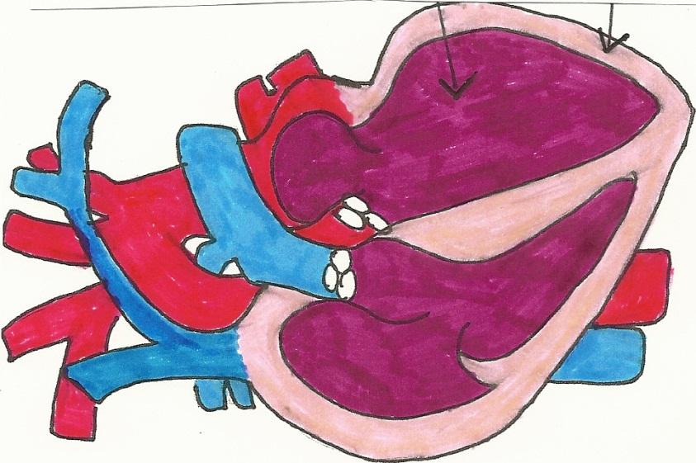
Dilated Cardiomyopathy
(DCM)
NORMAL
DILATED CARDIOMYOPATHY
Enlarged
Ventricle
Thinned
Wall
(Illustration by Brittany Woznicki)

Slide 10
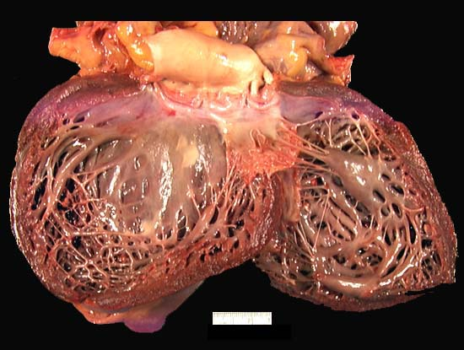
DCM Characteristics
Ventricle Enlargement
Thinning of Ventricle Wall
Impaired systolic function
(of left and/or right ventricles)
Interstitial Fibers
Atrophic and hypertrophic myocardial fibers
Degenerative changes of cardiac myocytes
(Image retrieved from http://path.upmc.edu/cases/case161.html)
(Image retrieved from http://en.wikipedia.org/wiki/Cardiomyopathy)
(Porth, 2009) & (National Heart Lung and Blood Institute [NHLBI], 2011) & (Merriam-Webster, 2012)

Slide 11


Causes of DCM
Genetic
  35% of cases are linked genetically to family origin
Nongenetic Causes
  Infections
  Toxins (alcohol, cocaine)
  Deficiencies of thiamine, calcium, and/or magnesium
  Chemotherapeutic Agents
  Coronary Artery Disease
  Atrial Fibrillation or Supraventricular Tachycardia
  End Stage Kidney Disease
(Porth, 2012) & (PubMed Health, 2012)
Images Retrieved from Microsoft Office Clip Art

Slide 12
Disease Process of Dilated Cardiomyopathy
Heart muscle begins to dilate
Heart muscles stretch and thin
Heart cannot contract normally (pump blood efficiently)
Heart becomes weaker
Heart failure!
(NHLBI, 2009)

Slide 13

Clinical Manifestations
Shares Similar Symptoms of Heart Failure
Shortness of breath, dyspnea, swelling in extremities, fatigue, etc.
Low Ejection Fraction
< 25% in advanced stages, decreased systolic function
Image from Microsoft Office Clip Art
Secondary Complications
Blood clots in the heart, arrhythmias, heart valve problems.
(Porth, 2009) & (McKenna, 2009)

Slide 14

Case Study
A patient presents with shortness of breath that has become increasingly worse over the last 3 days. The patient complains of diaphoresis and swelling of her lower extremities. The patient also reports she has been running a fever with chills and has been feeling palpitations in her chest.
(Image from Microsoft Office Clip Art)

Slide 15
Case Study
Which of the following symptoms experienced by this patient are directly related to the diagnosis of dilated cardiomyopathy?
Shortness of Breath
Correct! This is a common symptom of heart failure and DCM as well!
Fever and Chills
Sorry, this is not directly related to this disease.
Palpitations
Right! Palpitations can often occur as a secondary cause of DCM due to certain cardiac arrhythmias!

Slide 16
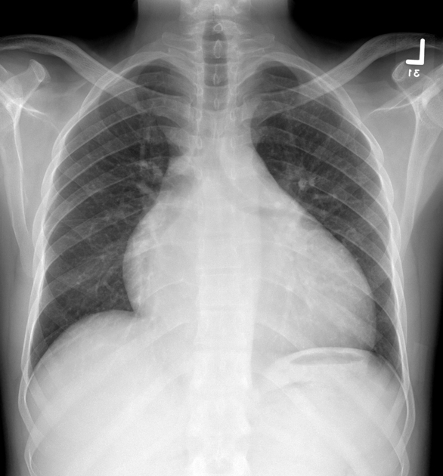
Diagnostic Testing
“A diagnosis of DCM requires evidence of dilation and impaired contraction of the left ventricle or both ventricles (eg, left ventricular ejection fraction < 40 percent...)” (Weigner, 2012, p.1).
Detailed Clinical History
Thorough Physical Examination of Patient
Chest x-ray
Echocardiogram
Electrocardiogram
Enlarged Heart
(PubMed Health,2012) & (Hershberger, 2011)
(Used with permission from Dr. H. Alsalam, Radiopaedia.org)

Slide 17
Case Study
An echocardiogram is performed on the patient. Which of the following findings would you suspect to discover when reading the results of the exam related to dilated cardiomyopathy?
Thickening of Ventricle Walls
Sorry! DCM causes thinning of the ventricle walls. Try Again!
Ejection Fraction of 20%
Yes! It is common for patients to have an EF of <25% in advanced stages.
Ventricle Enlargement
Correct! As the heart weakens the ventricles lose shape and enlarge.

Slide 18

Treatments
Click on a box to find out its significance in Dilated Cardiomyopathy!
ACE Inhibitors
Prevent Vasoconstriction
Diuretics
Reduce Preload
Beta Blockers
Control Heart Rate to Reduce Oxygen Demand of the Heart
ICD Placement
OR Heart Transplant!
“The 2005 ACC/AHA guidelines recommended beta blockers in patients with current or prior symptoms of [heart failure] and left ventricular dysfunction” (Colucci, 2012, p.1).
(Porth, 2009) & (AHA, 2012)

Slide 19
Case Study
A clinical diagnosis of dilated cardiomyopathy is made. It is determined that the patient should be placed on P.O. Metoprolol 25mg BID. What is the reasoning for placing this patient on a beta blocker?
Increase Heart Rate
Try Again! Beta blockers will actually decrease heart rate.
Reduce Preload
Sorry! This is actually the job of a diuretic.
Reduce Oxygen Demand of the Heart
You Got It! A beta blocker will slow the heart rate, thus decreasing the oxygen demand of the heart.

Slide 20
Summary
Cardiomyopathy can affect both the mechanical and electrical functions of the heart.
Many times dilated cardiomyopathy may go unrecognized. A patient may not present with signs and symptoms until later stages due to the compensatory mechanisms of the body.
As a nurse practitioner it is crucial to become familiar with signs and symptoms of this disease and how to diagnose it.
By becoming familiar with the diagnostic testing and treatments for dilated cardiomyopathy, the nurse practitioner can help to diagnose DCM in earlier stages.
This concludes the tutorial!

Slide 21
References

Slide 22
References (cont.)

